Slide 1
Hash Functions and Tables
Definitions and introduction
Hash Functions
  Security Applications
  Desirable Properties
Hash Tables as a Data Structure
  Collision Handling Approaches
  Open Hashing
  Quadratic Hashing
  Chained Hashing
  Sizing hash tables
Pigeon Hole Sort Application

Slide 2
Definitions
A hash function generates a signature from a data object. Hash functions have security and data processing applications.
A hash table is a data structure where the storage location of data is computed from the key using a hash function. For this application the storage location is the signature returned by the hash function with the key as the data object.
The pigeon hole sort is an approach to sorting data in which the sorted storage location is computed linearly from the key.
A hash collision occurs when the hash function computes the same signature or hash for 2 different input keys. For security applications collisions are highly undesirable. For data storage applications collisions are inevitable.

Slide 3
Introduction
Hashing functions, tables and algorithms have many applications. These include security applications and efficient sorting and searching strategies. Much research and investigation has been carried out into this area , the results of which includes freely available programming libraries with full source code which efficiently implement many of the applications described in these notes.
The Perl and Python languages provide access to hashes as integral language data storage features in a similar manner to arrays.

Slide 4
Security applications of Hash Functions
a. Generating the encrypted signatures of passwords so that the actual passwords do not need to be stored on systems which authenticate these.
b. Storing sets of file signatures off-line or in write-once storage so that suspicious file and system modifications can be detected by periodically comparing expected and actual signatures.
c. Generating the keys and digital signatures used in e-commerce and for encrypting private messages and sensitive data.

Slide 5
Desirable Property of Hash Functions in Security Applications
Consider a function sig=h(obj) where obj is the data object, h is the hash function and sig is the signature.
For h to have security applications this should be a one way function. This means that knowledge of sig and h should not be sufficient to obtain knowledge of obj, if the latter is an unknown member of a large enough possible set of objects.

Slide 6
Hash Tables as a Data Structure
A data processing application of hash functions is for an efficient method of data storage and access known as the hash table. The hash function is used for locating data within a hash table based on the signatures computed from record keys. Storing data with the location based on the key enables the most rapid possible searching for data based on the key. This also requires that the hash function is computed quickly.
For general purpose data storage applications where sorting is not a consideration, the hash function will be selected to achieve even scattering of storage locations to minimise the probability of record clustering and hash collisions. Some collisions will be inevitable, due to the need to limit the number of possible storage locations.

Slide 7
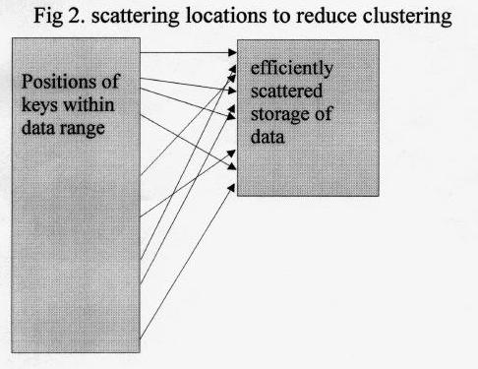
Hash function suited for general purpose data storage

Slide 8
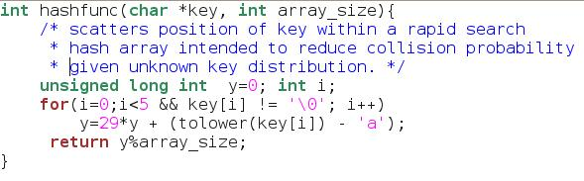
Source code for scattering hash
If the application is intended to enable the fastest possible random searching and access of data, the hash function is designed to reduce the number of collisions which otherwise result in longer searches for clustered data.

Slide 9
Handling collisions
If the number of possible keys greatly exceeds the numbers of records, and of computed storage locations, hash collisions become inevitable and so have to be handled without loss of data.
3 approaches are used to handle collisions:
open hashing
quadratic hashing
chained hashing

Slide 10
Open hashing 1
If a key can be stored in its computed location store it there.
Else go to the next unused table location and store the record there. Rotate to the first location (array_element[0] ) after the highest. Use the remainder when dividing the position number by table size; i.e.
array_location = position_number % array_size;
this modulus always maps any integer to a valid array_location .

Slide 11
Open hashing 2
As either nothing or 1 record is stored per array location, there must always be more locations in the table than stored records.
Also if deletion of data is required there must also be some means of flagging data in a location having been deleted as different from a previously unused location, otherwise records which may have been located after a deletion point will no longer be efficiently accessible.

Slide 12
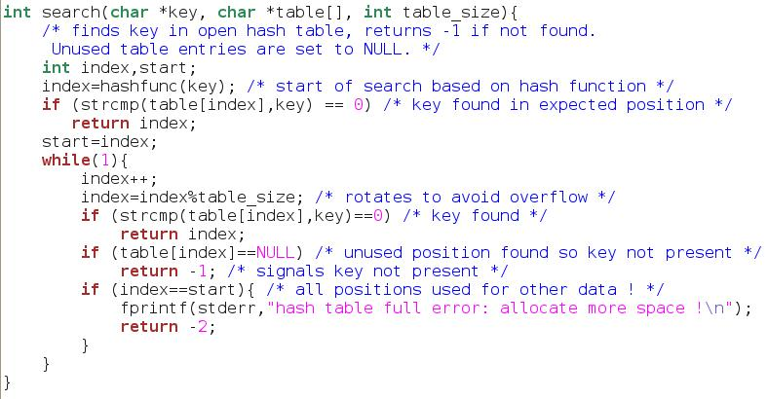
Open hashing search code

Slide 13
Quadratic hashing 1
If a location for a key is already occupied by another record, find the next unused location by trying locations separated from the calculated location by 1,4,9,15,25,49... positions (i.e the series of perfect squares) on from the original record position (using the modulus operation described for open hashing).
The advantage of this approach is that data is less likely to become clustered (and therefore requiring more access operations) than would occur with open hashing.

Slide 14
Quadratic hashing 2
Calculating the successive squares can also be reduced to quicker addition by virtue of the fact that the series of quadratic locations 0,1,4,9,16,25... from the origin are separated by the series of jumps 1,3,5,7,9... from each other.
This approach will require special care in the sizing of the hash table. If not there is a greater risk of jumps skipping over unused positions and revisiting previously searched ones.

Slide 15
Chained hashing 1
This involves co-location of 0 or more data items using a singly-linked list starting at the array location returned by the hash function.
If the array size and hash function are chosen in order to reduce the frequency of collisions such that say, 90% of records are the only record at their array location, then it is probable that a further 9% will be chained in list lengths of 2, and 0.9% will be triply located, 0.09% will by quadruply located etc.

Slide 16
Chained hashing 2
This would result in an average number of comparisons needed to find a single data item of approximately (0.9n + 0.09n*1.5 + 0.009n*2 + 0.0009n*2.5...)/n which is 1.0555555, or close enough to 1.0 to make little difference.
If the hash table is an array of pointers, each pointer is either the head address of a linked list or a null to indicate an unused position.

Slide 17
Sizing hash tables
Open and quadratic (direct storage) methods which can only store 1 record per hash table location clearly need more array locations than records. Collision and clustering problems are more likely to occur if the number of records is close to the table size.
The performance of chained hashes will deteriorate more gradually as the occupancy ratio increases beyond 1 record per array location, in the worst case to that of the chained structure (e.g. single linked list) indexed at a single "array" location. A good rule of thumb is that for a table efficiently to store n keys it should have a size of at least 3n/2.

Slide 18
Special sizing requirement for quadratic hash
The minimum table size should be increased to the next prime number of the form 4k+3 where k is an integer, as this guarantees that every slot will be visited:
(Barron, D.W. & Bishop J.M. "Advanced Programming: A Practical Course" John Wiley & Son).
Primes which meet this requirement include 11,19,23,31,43,47,59,67,79 (e.g. 11 = 4*2 +3 ) and many others.

Slide 19
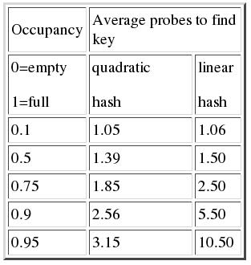
Performance Table
Barron, D.W. & Bishop J.M. "Advanced Programming: A Practical Course"

Slide 20
Pigeon Hole Sort 1
In special cases, the hash table can store data in sorted order. This is known as the "pigeon hole sort", named after the way mail was sorted by hand in postal sorting offices. This gives a number of comparisons and record moves both to the order of N, i.e. approximately 1 comparison and move is needed per record to find or store the data in sorted order.
This is more efficient than any other sort algorithm, with the best alternatives such as quick sort giving numbers of moves and comparisons both to the order of Nlog₂N where there are N data items.
This approach is not general purpose however. Keys are only suitable if they are distributed evenly across a known range of values.

Slide 21
Pigeon Hole Sort 2
We use this hashing technique implicitly when deciding where to open a dictionary in order most quickly to find a word (the "key") and definition (the rest of the data record associated with the key or the "value").
For example if searching for the word "corrugated" we are likely quickly to estimate from the fact that the word is about 2/3rds through the words starting with the third of the 26 letters of the alphabet that "corrugated" is likely to be approximately 1/10th of the way through the dictionary. We would therefore probably start looking for this word by opening the dictionary 1/10th of the way through .
This technique can be cascaded, e.g. in a similar manner to how snail mail is sorted in more than one place.

Slide 22
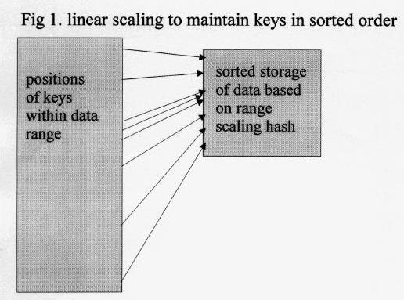
Hash function for Pigeon Hole Sort 1

Slide 23
Hash function for Pigeon Hole Sort 2
Supposing the hash function were to take the first three letters from the alphabetic key, and calculate positions 0 for a, 1 for b, 2 for c etc. up to 25 for z. The value of the first letter could be multiplied by 625, added to the value of the second letter multiplied by 25 and added to the value of the third letter. In 'C':
y1=625*(tolower(key[0]) - 'a') + 25*(tolower(key[1]) - 'a') + (tolower(key[2]) - 'a');
This would give the lowest key "aaa" a hash of 0 and the highest key "zzz" a hash of 16275. Suppose our table size were 997. We could then map this range (0-16275) to an array index between 0 and 996 using, in 'C' :
y=(int)(y1*995.999/16275);
Note the slight rounding down of range and use of float arithmetic to avoid rounding and overflow bugs.

Slide 24
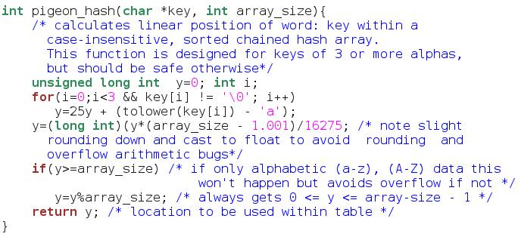
PHS hash function source

Slide 25
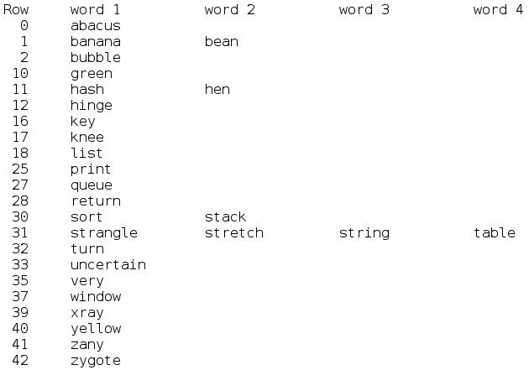
Occupied rows and chains after a PHS
NULL rows e.g. 3-9, 13-15, 19 etc. within the range
0 - 42 are not listed.
Occupancy of rows: 22/43 = 0.51
Data items per row: 28/43 = 0.65
Average number of comparisons to sort data per key:
32/28 = 1.143

Slide 26
Further reading
Loomis, Mary E.S. "Data Management and File Structures" Second Edition Prentice Hall International Editions
Barron, D.W. & Bishop J.M. "Advanced Programming: A Practical Course" John Wiley & Sons
http://en.wikipedia.org/wiki/Hash_table

